Slide 1
Web Development with F#
Ryan Riley and Daniel Mohl
@panesofglass and @dmohl
wizardsofsmart.net
Blog.danielmohl.com

Slide 2


Who Are These Guys?
Ryan Riley (@panesofglass and Daniel Mohl (@dmohl)
ryan.riley@panesofglass.org
dmohl@yahoo.com
Examples:
https://github.com/dmohl/FsOnTheWeb-Workshop/

Slide 3


Slide 4


F# Fundamentals
What is F#?
F# Interactive
Values and Functions
Types and Type Inference
Lists and Sequences
Pattern Matching
Units of Measure
Mixing Classes and Functions

Slide 5
Why F# in Web Development?
F#/JavaScript Commonalities
Web solutions are more complex than ever
Concise yet readable syntax
Great features for building highly scalable, modern web solutions (async workflows, MailboxProcessors, etc., etc.)
It’s now easier than ever with F# Tools for VS2012 Express for Web.

Slide 6
Building an ASP.NET MVC 4 Solution
Looking at a C# example

Slide 7
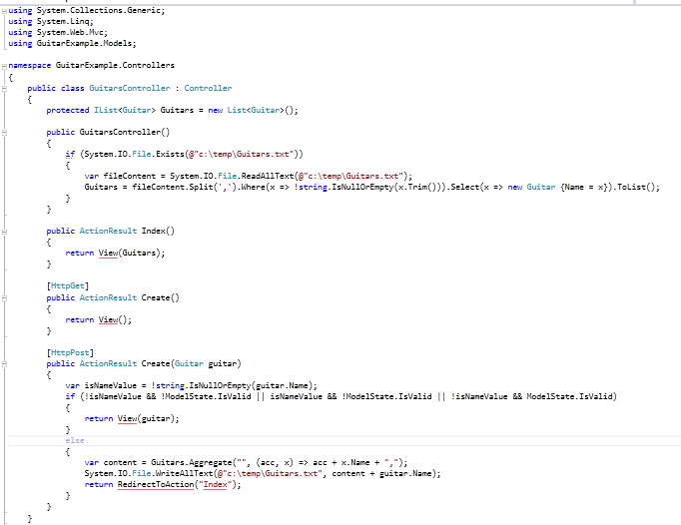
GuitarController.cs

Slide 8
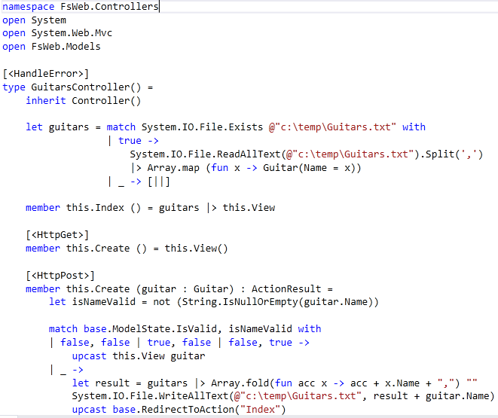
GuitarController.fs

Slide 9
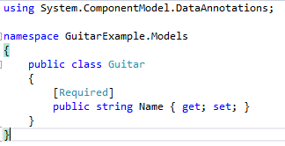
Guitar.cs

Slide 10
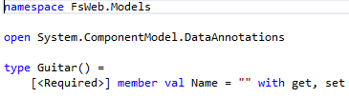
Guitar.fs

Slide 11

Building an ASP.NET MVC 4 Solution
Looking at a C# example
Create an F# equivalent solution

Slide 12
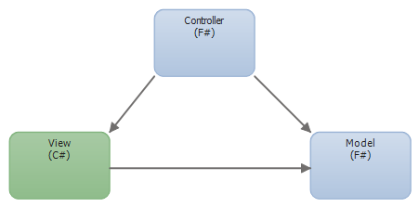
Solution Breakdown

Slide 13

Lab Time
Your Turn

